Slide 1


STUDENT DROPOUT PREDICTION
Enhancing Educational Success through Early Intervention with Machine Learning.
Group 1 Members:
Abigaba Prosper
Ekou David
Imienu Charity
Kiwanuka Kenneth
Rwotolara Innocent
Ainembabazi Allan

Slide 2

Problem Statement & Goal
Problem: High dropout rates limit students’ future opportunities and negatively affect education systems and national development.
Goal: Develop a machine learning model to predict student dropouts using academic, demographic, and socio-economic factors.
Why it matters: Early prediction helps schools and policymakers design timely interventions (e.g., tutoring, counselling, financial aid), reducing dropout rates and improving long-term student success.

Slide 3
Dataset & Description
Dataset Overview: UCI ML Repository (4,424 students, 36 original features + 4 simulated Tanzania-specific features + 1 target)
Key Features:
Demographics: Age at enrolment, Gender, Marital status, Nationality
Academic Background: Previous qualification, Admission grade, Course
Academic Performance: Curricular units approved/not approved, Grades
Financial: Tuition fees up to date, Scholarship holder
Economic Context: GDP, Unemployment rate
Simulated: Location(Urban/Rural), Internet Access (0-1 score), Teacher Quality (0-1 score), School Distance(0.5-15 km)

Slide 4
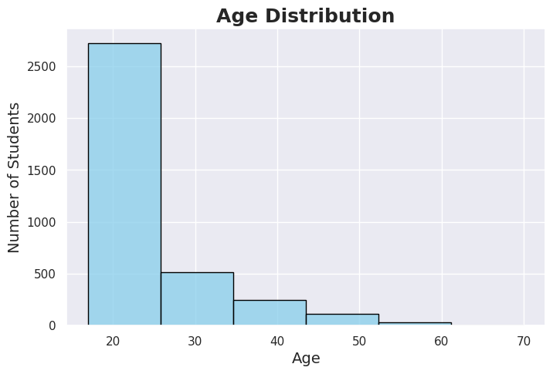
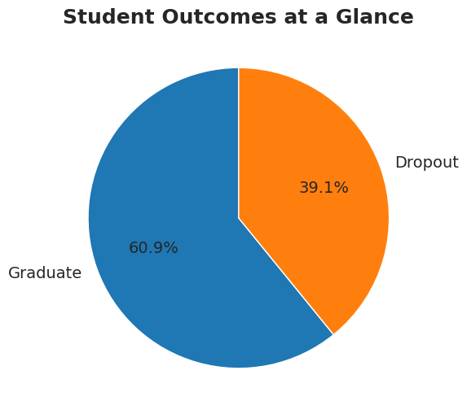
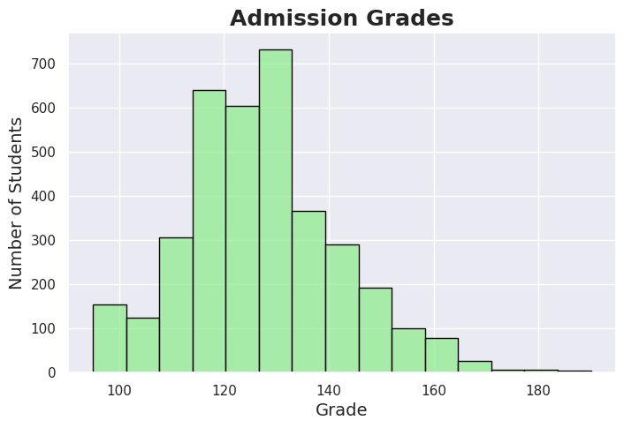
Exploratory Data Analysis
Univariate Insights:
Age Distribution: Right-skewed, most in 20s (Peaks at 18-25; Older students may face higher dropout risks)
Admission Grades: Normal around 120-140 (Few low scores; Dataset skews toward higher performers)
Bivariate/Multivariate Insights:
Outcomes: 60.9% Graduate, 39.1% Dropout (Class imbalance requires focus on predicting dropouts)
Admission Grade vs. Outcome: Similar averages (Non-academic factors like finances key)
School Distance by Location: Rural farther (Accessibility increases rural dropout risk)
Internet Access vs. Outcome: Little variation (Other factors more influential than connectivity alone)
Top Correlations: Academic factors dominate (Units approved/grades strongest, but socioeconomic contribute)

Slide 5
Pre-processing: Removed duplicates/outliers; Encoded/scaled features; PCA (95% variance retained); SMOTE for imbalance; 80/20 split
Machine Learning Approach & Performance
Models:
Classical (SVM, Gradient Boosting, Logistic, KNN; Tuned via GridSearchCV; Stacking Ensemble)
Neural Network (Sequential: 128-64-1 layers, ReLU/Sigmoid, Dropout/BatchNorm; Adam optimizer, EarlyStopping)
Performance Metrics:
Model | Accuracy | Precision | Recall | F1
NeuralNetwork | 0.90 | 0.91 | 0.93 | 0.92
GradientBoosting | 0.89 | 0.90 | 0.92 | 0.91
Stacking | 0.89 | 0.90 | 0.92 | 0.91
Logistic | 0.89 | 0.92 | 0.90 | 0.91
SVM | 0.86 | 0.89 | 0.89 | 0.89
Best Model Insights: Neural Network(F1 ~0.90; Strong on graduates, balanced; Confusion Matrix: 168 TP Dropouts, 328 TP Graduates, few errors; ROC AUC 0.93: Excellent discrimination)

Slide 6
Key Findings:
Up to 92.5% accuracy in identifying at-risk students
Academic performance strongest predictor; Rural factors (distance, internet, teacher quality) increase dropout risk
NN outperforms classical models slightly in F1/ROC
Holistic model captures academic + socioeconomic influences
Recommendations
Hyperparameter tuning of the model for better performance
Since the most powerful predictor is academic performance during the course, further data collection should incorporate data like attendance records.
Deploy the model as an early warning system for vulnerable students to enable proactive counselling and support interventions.
Conduct a bias audit to ensure the model predictions are fair and equitable across all student demographics.
Limitations:
Dataset limited to one region.
Possible bias in self-reported variables.

Slide 7

Thank You!

